Slide 1
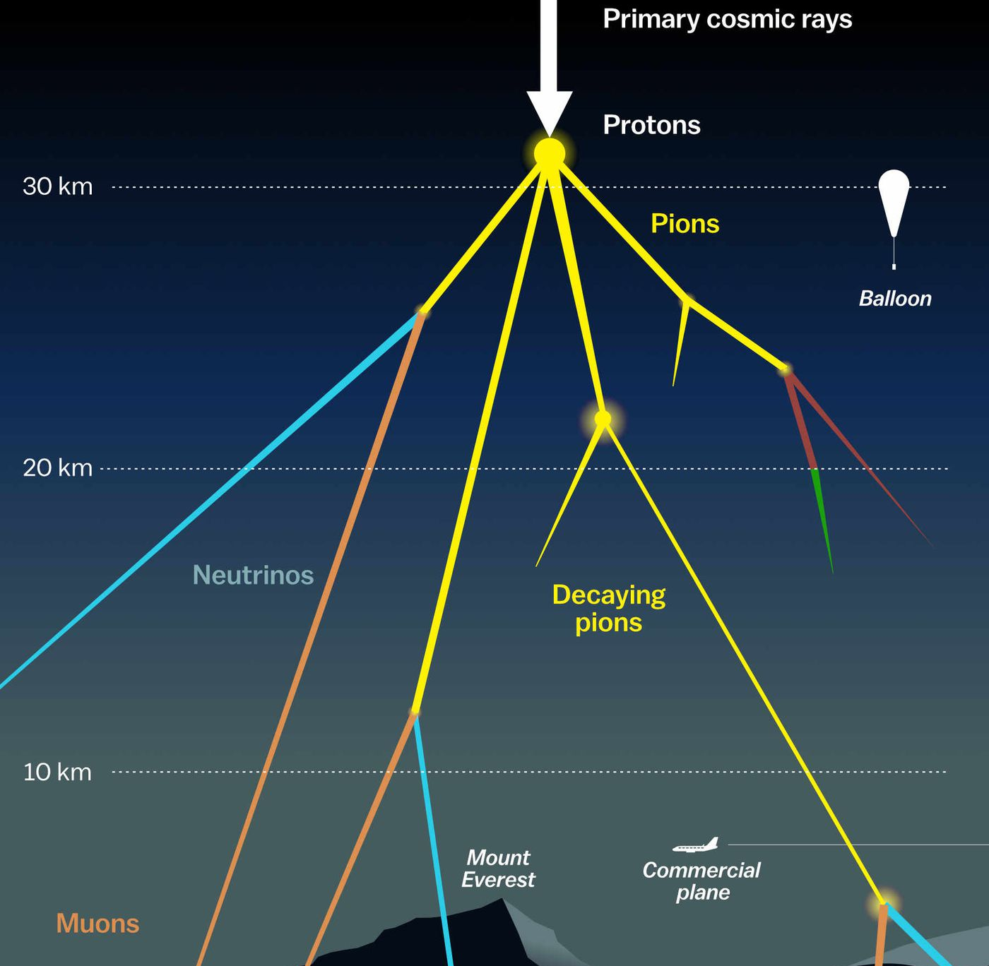

Multiplicity reconstruction Pascal Gutjahr
April 16, 2024
Source: NASA

Slide 2
NuGen – dataset exploration
Glashow

Slide 3
NuGen – Multiplicity reconstruction

Slide 4
Different flavors

Slide 5
Multiplicity – energy correlation

Slide 6
Uncertainty cuts (energy dependent)

Slide 7
Selection

Slide 8
Different cuts (uncertainty, number of muons)

Slide 9
Down-going events only

Slide 10
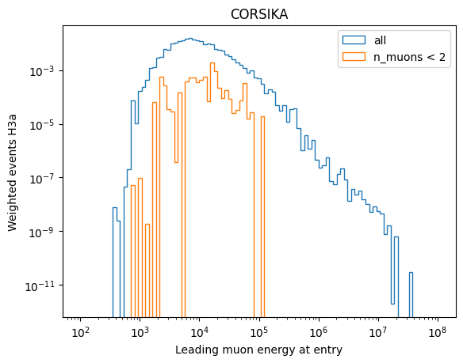
Theoretical limits
No single muons induced by an airshower above ~150 Tev

Slide 11
Correlation: number muons vs leading energy

Slide 12
Correlation: number of muons vs bundle energy
Rule of thumb: Number of muons ≈ bundle energy at entry in MeV x 2

Slide 13
Energy reconstruction

Slide 14
GFU reconstruction
A lot of caveats…
SplitInIceDSTPulses not available
Network trained on down-going muons only
Has never seen a neutrino
Tries to estimate the number of muons at detector entry

Slide 15
Conclusion
test network to reconstruct muon multiplicity
energy reconstruction trained on leading muon energy
everything is preliminary
overall, the selection seems to work
GFU reconstruction does not work so far
To my muons:
a lot of software issues (installation and also new iceprod simulation, filters don’t work,…)
preparing training data for some muon reconstructions (for precut)
preparing training data for neutrino energy reconstruction (for Basia)
new master student in Dortmund – prompt neutrinos

